Slide 1


Latest Exam Pattern 2024
Techie CodeBuddy
( Free Placement Help )

Slide 2
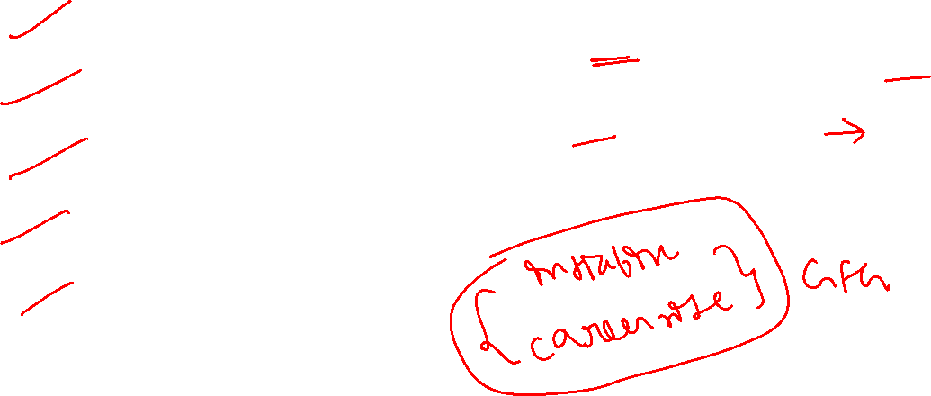
Tech Mahindra Hiring 2024
We Will Discuss :
Tech Mahindra Hiring Process
Tech Mahindra Exam Pattern
How many Rounds ?
Tech Mahindra Exam Syllabus
How to start preparation
What to do for Super Coder ?
Roles | CTC
ASE | 3.5 LPA
Super Coder | 5.5 LPA

Slide 3
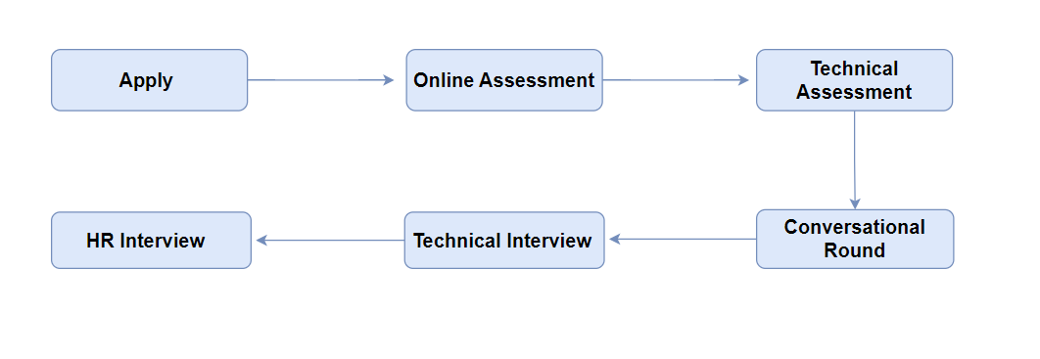
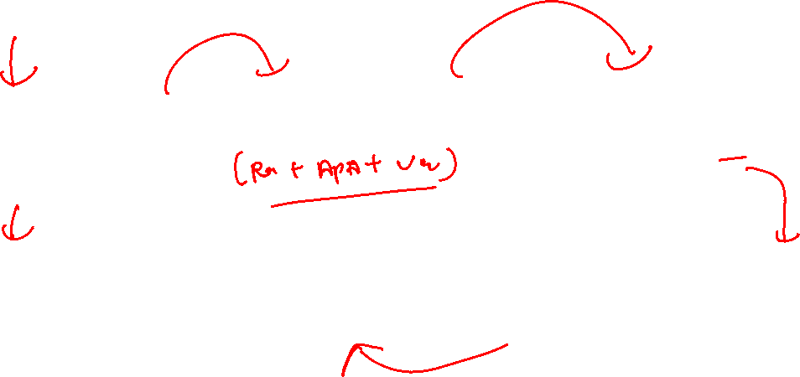
Tech Mahindra Hiring Flow

Slide 4
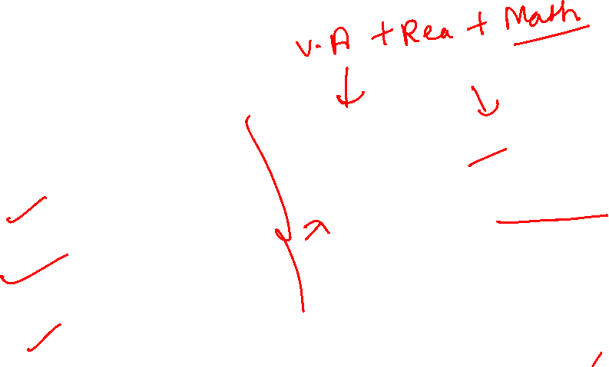
Total Rounds ?
Round 1 | Aptitude + Essay Writing
Round 2 | Technical + Psychometric Test
Round 3 | Conversational Round
Round 4 | Technical Interview
Round 5 | HR Interview

Slide 5
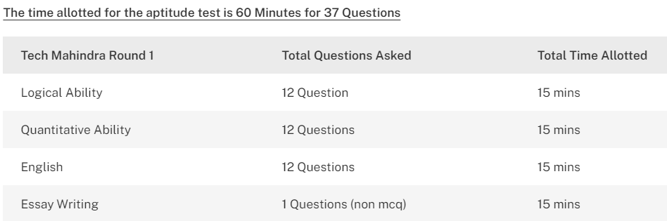
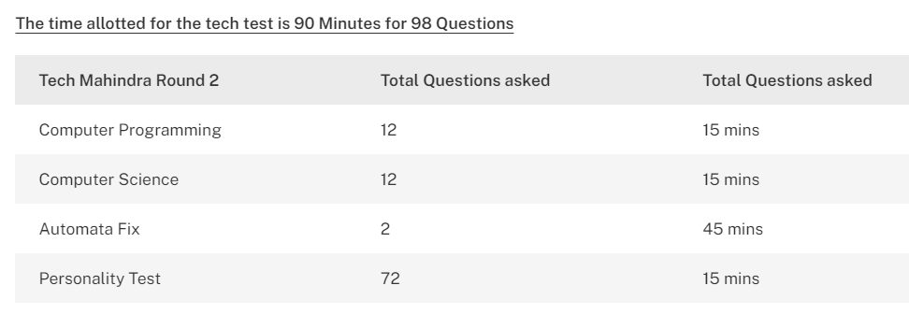
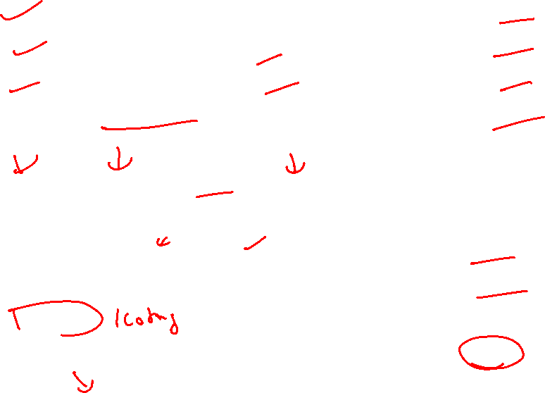

Slide 6
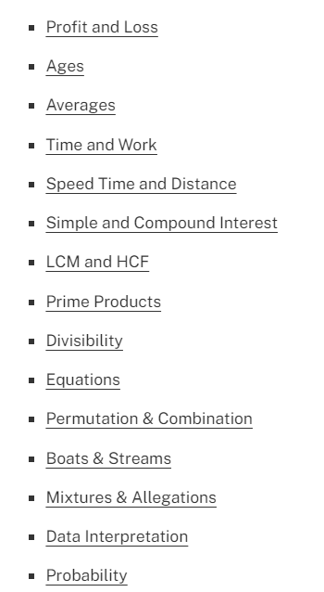
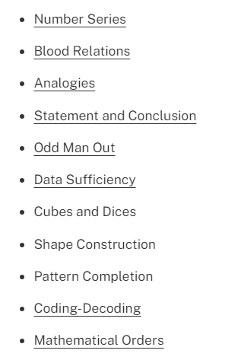
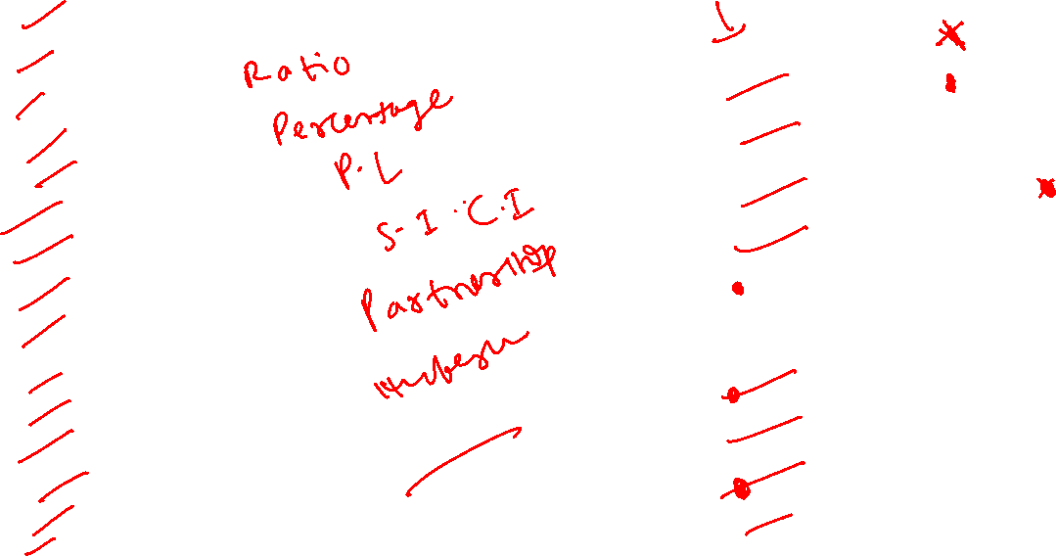
Detailed Syllabus of Written Test

Slide 7
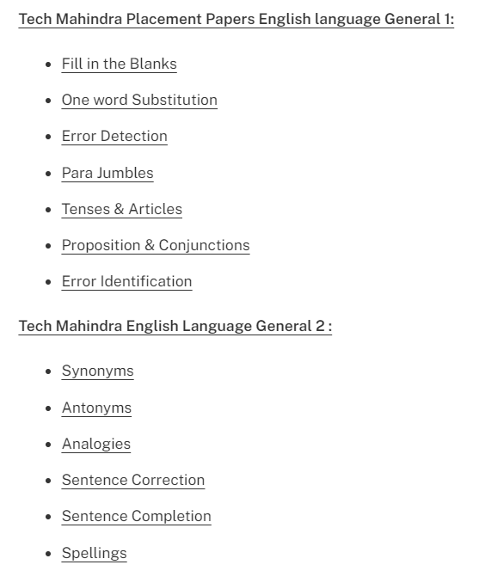
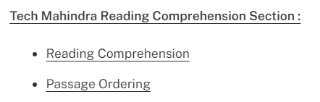
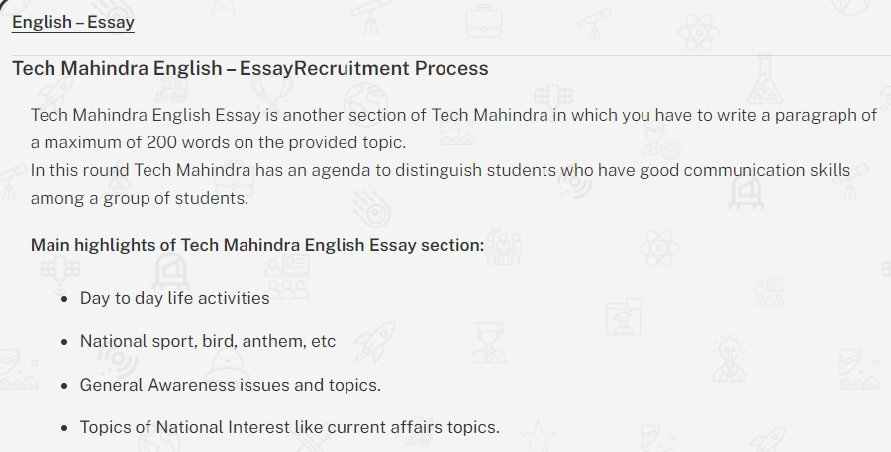


Slide 8
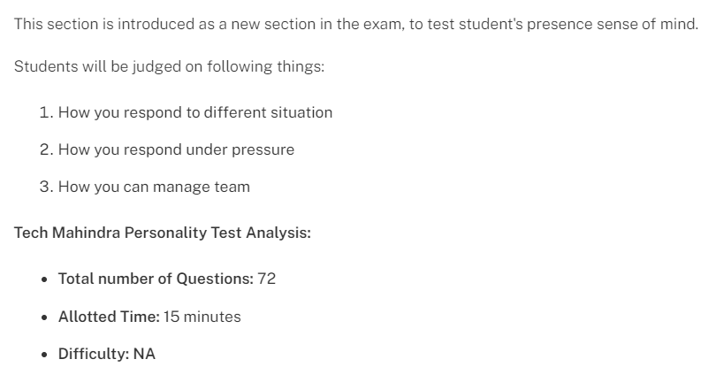

Detailed Syllabus of Technical Assessment
Personality/Psychometric Test

Slide 9
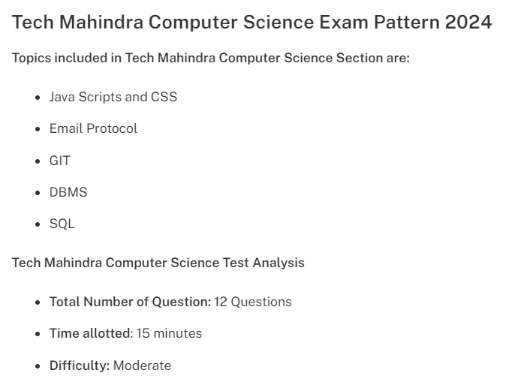
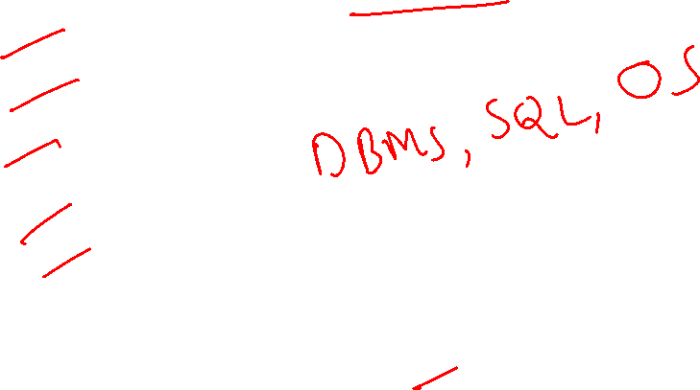

Slide 10
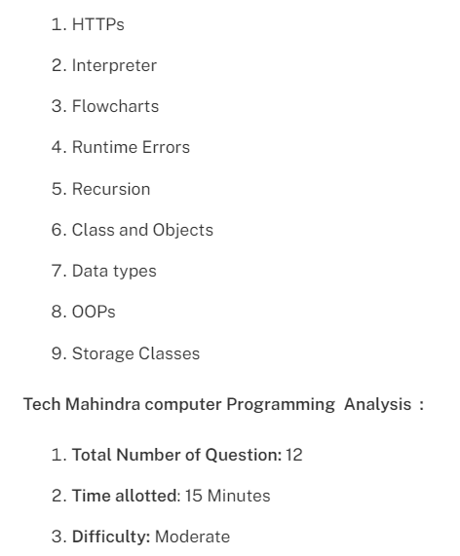

Detailed Syllabus of Computer Programming

Slide 11
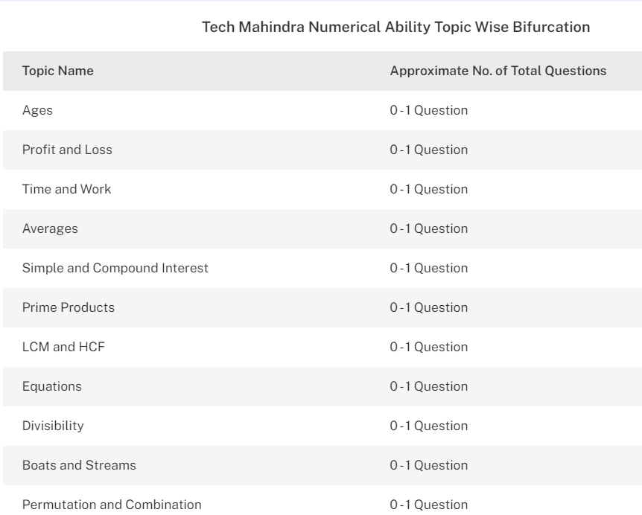
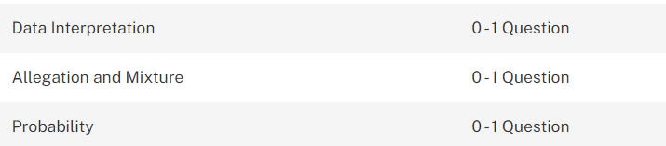


Slide 12
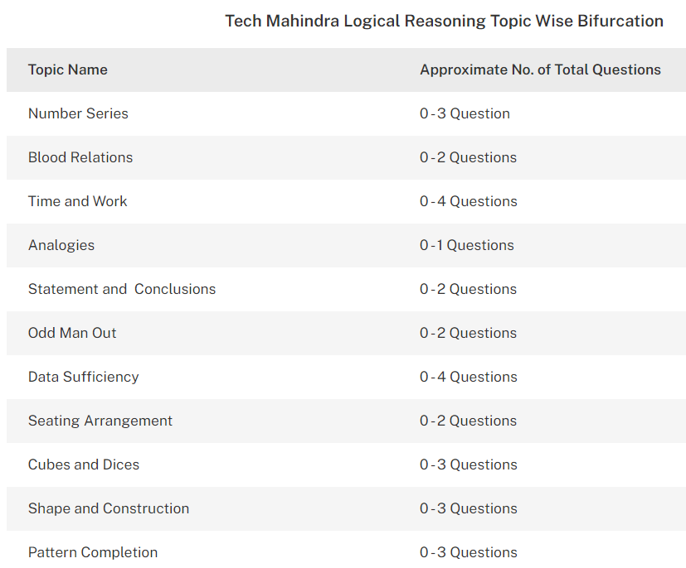
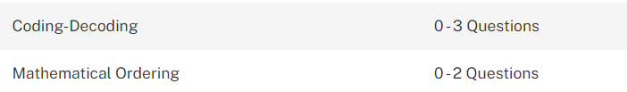


Slide 13
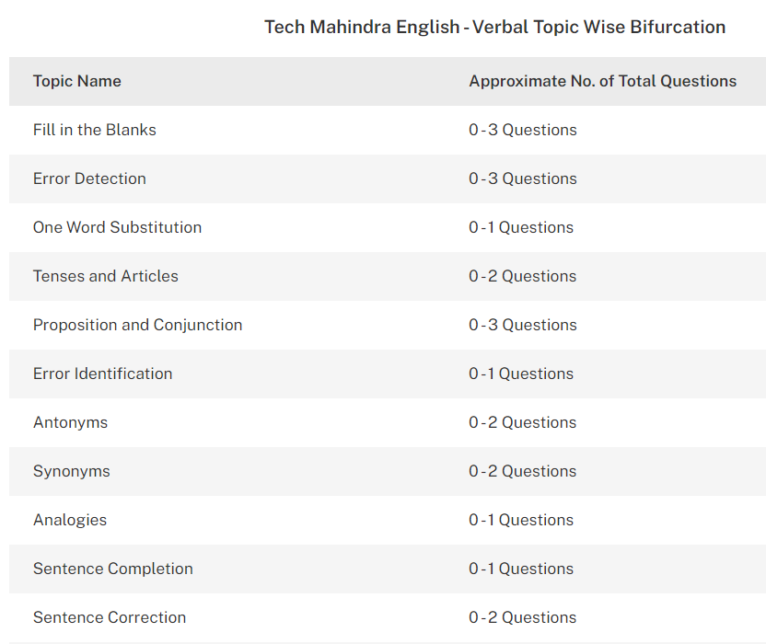
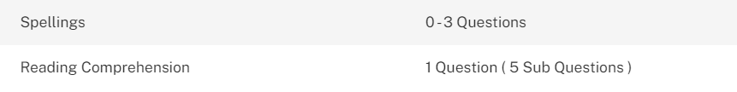

Slide 14
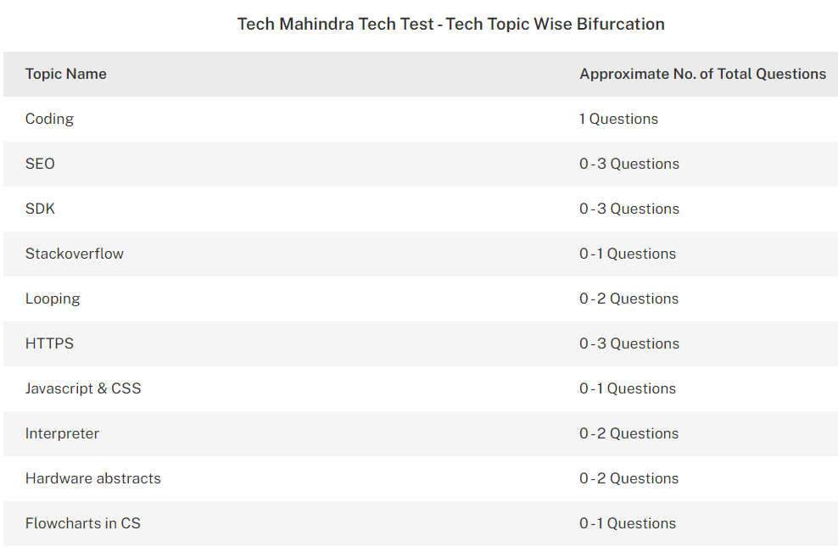


Slide 15
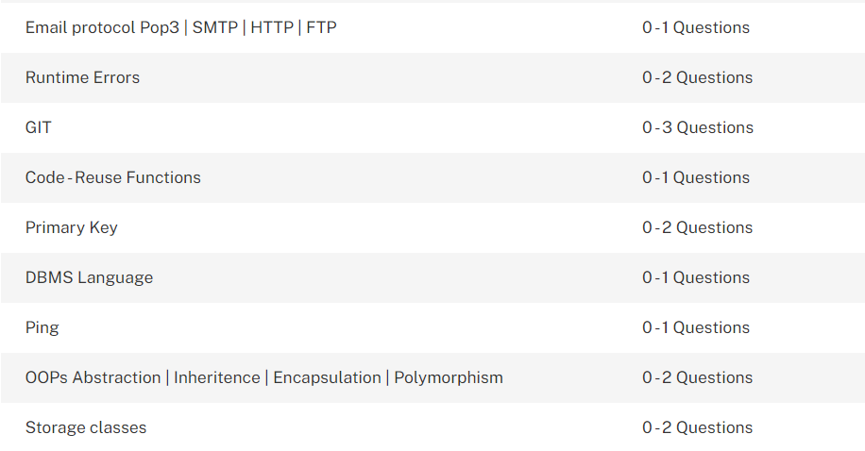

Slide 16
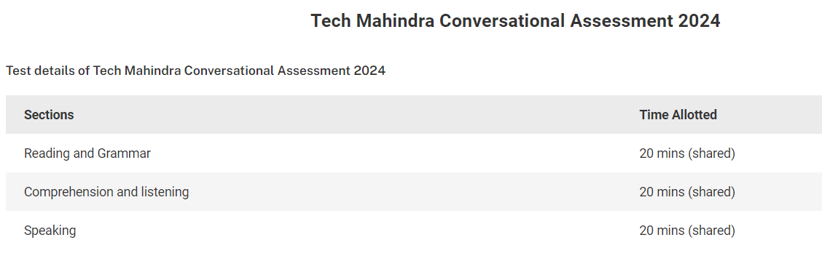
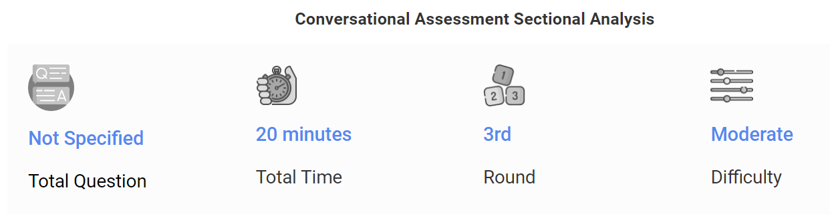


Slide 17
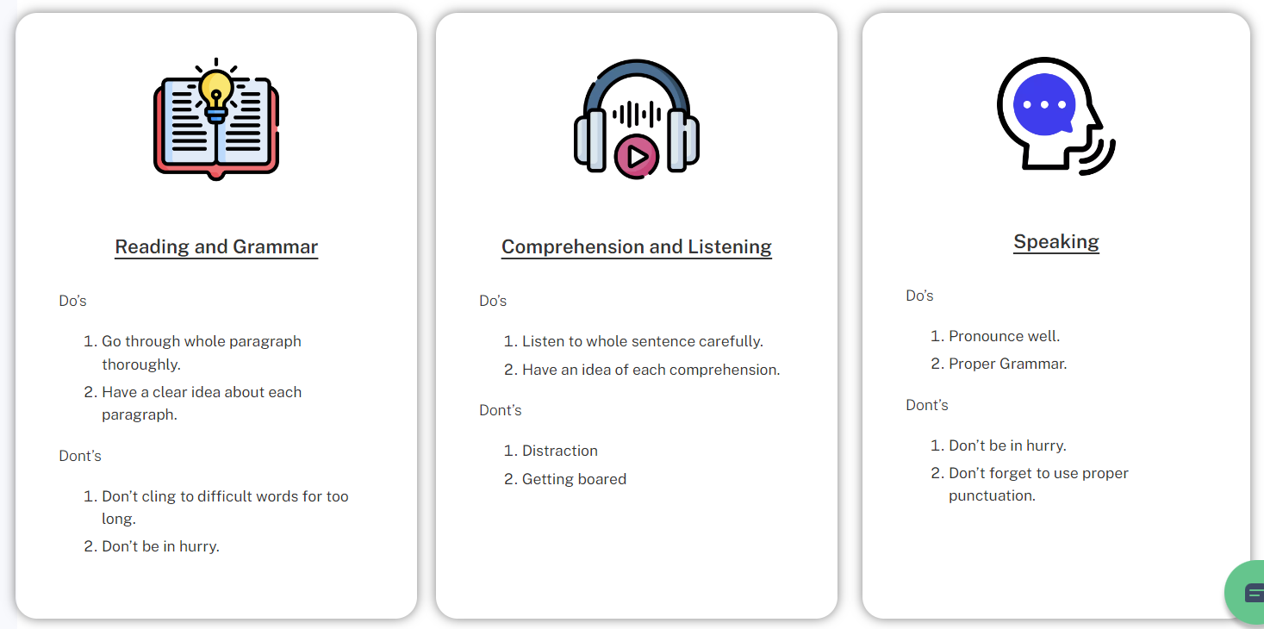


Slide 18
Thanks for Watching

